Slide 1


Multiple Regression with Categorical Variables
Notes:
In this presentation we discuss how categorical variables are dealt with in multiple regression models and provide examples.

Slide 2
Indicator (Dummy) Variables
Some variables are referred to as qualitative (categorical) variables
Qualitative variables do not yield quantifiable outcomes
Qualitative variables yield nominal- or ordinal-level information; used more to categorize items.
Qualitative variables are referred to as indicator, or dummy variables
Notes:
As you may recall from before, some variables are referred to as qualitative or categorical variables. Qualitative variables are variables that are not numerical. They describe data that fits into categories. For example the color of an individual’s eyes or name of the country of their residence can be considered as categorical variables. In regression modelling, qualitative variables are also referred to as indicator variables.

Slide 3
Monthly Salary Example
As an example, consider the issue of sex discrimination in the salary earnings of workers in some industries.
In examining this issue, suppose a random sample of 15 workers is drawn from a pool of employed laborers in a particular industry and the workers’ average monthly salaries are determined, along with their age and gender. The data are shown in the following table. As sex can be only male or female, this variable is coded as a dummy variable with 0 = female, 1 = male.
Notes:
Here is an example where we consider the issue of sex discrimination in the salary earnings of workers in some industries. Suppose we have selected 15 workers randomly and we captured their age, salary, and gender. In this case sex can be only male or female, and therefore we can code this variable as a dummy variable where zero shows female and one shows male.

Slide 4
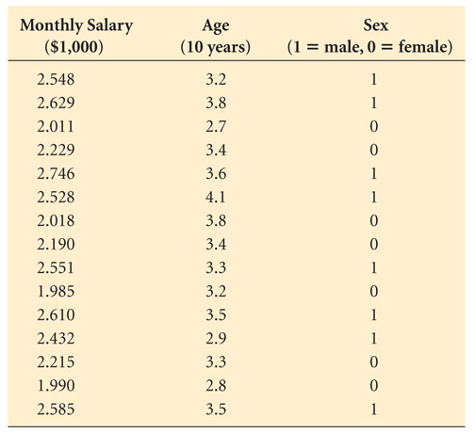
Data for the Monthly Salary Example
Notes:
24
The following table shows the data used for this example where we have three variables, age, sex, and monthly salary in thousands of dollars.

Slide 5
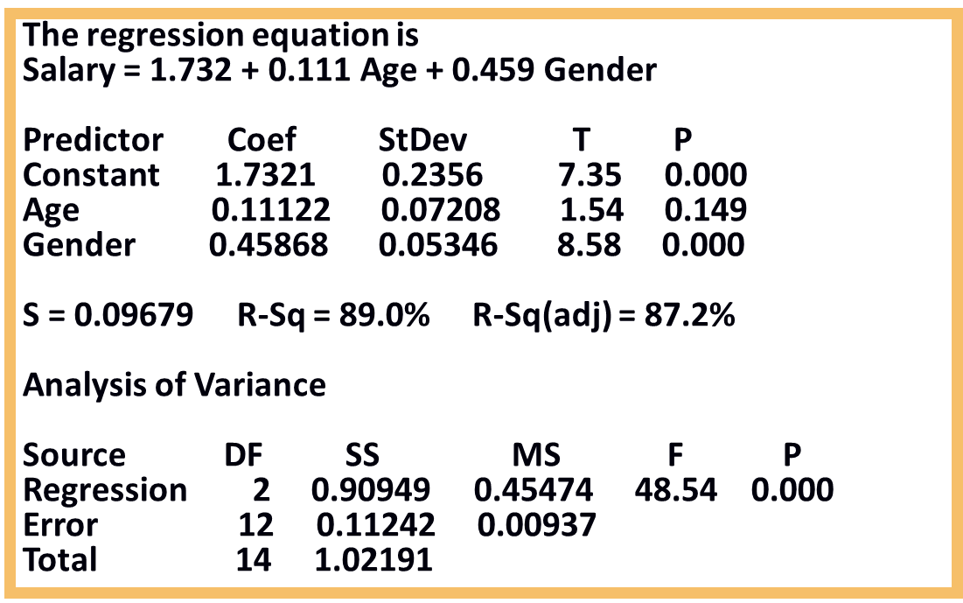
Regression Output for the Monthly Salary Example
Notes:
25
Here we can see the multiple regression model. Salary is equal to 1.73 plus 0.11 multiplied by age plus 0.45 multiplied by gender. As we can see, gender is also associated with a very small p value for the t-test, which means that it is a statistically significant variable. The coefficient is positive in this case, which is equal 0.45. This means that increasing the gender, which means moving from female that was presented with zero, to male which was presented by one, results in increasing the salary. In other words, we can conclude that males are earning more money compared to women in this data set. More specifically, we can say that males on average are earning 0.45 multiplied by 1000, which is nearly $450 more than women in the data set.

Slide 6
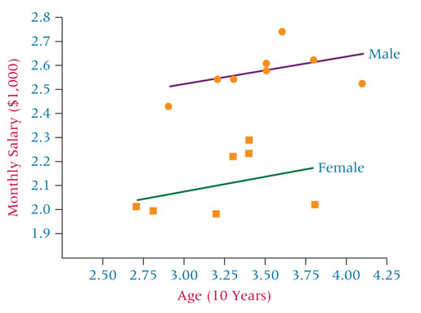
Regression Output for the Monthly Salary Example
Notes:
25
The following visualization also confirms that males are earning more than females in our data set. In this case we have two separate linear regressions lines, one for men and one for women. The average distance between the two lines should be $450 as we predicted before.

Slide 7
Dummy Variables with More than Two Levels
You can use binary coding 1 and 0, only if you have no more than two levels (e.g. Sex: only male and female levels)
For example, if the there are 3 levels and you code the categorical data as 1,2 and 3, the resulting model is going to be WRONG (because you are assuming that the distance between the first and the second category levels is the same as the distance between the second and the third levels).
In such cases, you should explicitly defined the variable as a factor.
Notes:
Of course binary coding of zero and one can be only used when we have two levels. For example, in the case of sex, we had only female and male levels. However, if we have more than two levels, for example if we have three levels, using numerical representation for representing these categories would be wrong. Because in that case we are assuming that the distance between the first and second category level is the same as the distance between the second and the third level. In such scenarios, we need to explicitly define the variable as a factor and let the model deal with the factor variable.

Slide 8
R Example: Predicting Sales of Baby Car Seats
library(ISLR) # install.packages('ISLR') if you had errors
## Warning: package 'ISLR' was built under R version 3.4.4
MyData<-Carseats[,1:8] str(MyData) # shows which variables are factor or numerical
## 'data.frame': 400 obs. of 8 variables: ## $ Sales : num 9.5 11.22 10.06 7.4 4.15 ... ## $ CompPrice : num 138 111 113 117 141 124 115 136 132 132 ... ## $ Income : num 73 48 35 100 64 113 105 81 110 113 ... ## $ Advertising: num 11 16 10 4 3 13 0 15 0 0 ... ## $ Population : num 276 260 269 466 340 501 45 425 108 131 ... ## $ Price : num 120 83 80 97 128 72 108 120 124 124 ... ## $ ShelveLoc : Factor w/ 3 levels "Bad","Good","Medium": 1 2 3 3 1 1 3 2 3 3 ... ## $ Age : num 42 65 59 55 38 78 71 67 76 76 ...
Model=lm(Sales~.,data=MyData) #Use all other columns to predict Sales
Notes:
Let’s consider an example in R. In this example, we try to predict the sales of baby car seats. The data set is part of the ISLR library. So, the first thing we do is load the library, then we select column one through eight of the car seat data set, which is a part of the ISLR library. For this we can write my data is equal to car seat bracket comma one through eight. We can use the str function to look at the structure of the variables in this data set. So str my data shows us that we have a data frame consisting of 400 observations and eight variables and showing individual variables as sales, competitor price, income, advertising, population, price, shelve location, and etc. The interesting variable in this case is the shelve location. As we can see all other variables are shown as numerical variables, the shelve location variable is shown as a factor variable which contains three levels, bad, good, and medium. This is referred to the location of a shelf in a retail store, which can be bad, good, or medium. We can use the lm function to build the model. In this case we have model equal to lm sales against dot data is my data. If you use dot, this means that we are using every single variable that is included in the data frame to predict the sales. In this case, the variables of interest would be competitor price, income, advertising, population, price, shelve location, and age.

Slide 9
R Example: Predicting Sales of Baby Car Seats
summary(Model)
## Call: ## lm(formula = Sales ~ ., data = MyData) ## ## Residuals: ## Min 1Q Median 3Q Max ## -2.7634 -0.6869 0.0231 0.6564 3.3245 ## ## Coefficients: ## Estimate Std. Error t value Pr(>|t|) ## (Intercept) 5.3592591 0.5241924 10.22 <2e-16 *** ## CompPrice 0.0929101 0.0041451 22.41 <2e-16 *** ## Income 0.0158393 0.0018395 8.61 <2e-16 *** ## Advertising 0.1141444 0.0080124 14.25 <2e-16 *** ## Population 0.0003004 0.0003622 0.83 0.407 ## Price -0.0953926 0.0026726 -35.69 <2e-16 *** ## ShelveLocGood 4.8399824 0.1526478 31.71 <2e-16 *** ## ShelveLocMedium 1.9570591 0.1255736 15.59 <2e-16 *** ## Age -0.0459990 0.0031817 -14.46 <2e-16 ***
Location of the Shelve in the Store
Notes:
The summary of the result model is shown in here. As we can see, except for population, all other variables are associated with a very small p value for the t-test, and therefore are statistically significant. We can also see two coefficients associated to the shelve location. Shelve location good and shelve location medium. This is discussed in more detail in the next slide.

Slide 10
R Example: Predicting Sales of Baby Car Seats
R considers one of the levels (by default the first level alphabetically, in this case “bad”) as a default value and then suggests how the model can be modified for cases when the two other level values (i.e. “good” and “medium”) are true.
In the previous examples, the coefficient for ShelvLocGood is 4.83, which means that if the Shelve Location was “Good” the sales would have been 4.83 units (in thousands) more compared to when the Shelve Location was “Bad” when all other variables are the same. Similarly, the sales would be 1.95 units more if the Shelve Location was “Medium” when compared to the base where the Shelve Location is “Bad”
Notes:
When we have categorical or factor variables in linear regression models, R considers one of the levels as a default value, such as how the model can be modified for cases when other levels are chosen. So, in the previous example, bad was considered as a default level for the model, and then the model was showing how the prediction can be modified if the value of the shelve location was good or was medium. The default level is normally the one that appears alphabetically first. In the previous example, bad was alphabetically first compared to good and medium and therefore was selected as the default level. In the previous example the coefficient for shelve location good was 4.83, which means that if the shelve location was good, the sales would have been 4.8 units in thousands of dollars more compared to when shelve location was bad. Similarly, the sales would have been 1.95 units more if the shelve location was medium when compared to the base for when the shelve location was bad.

